Slide 1
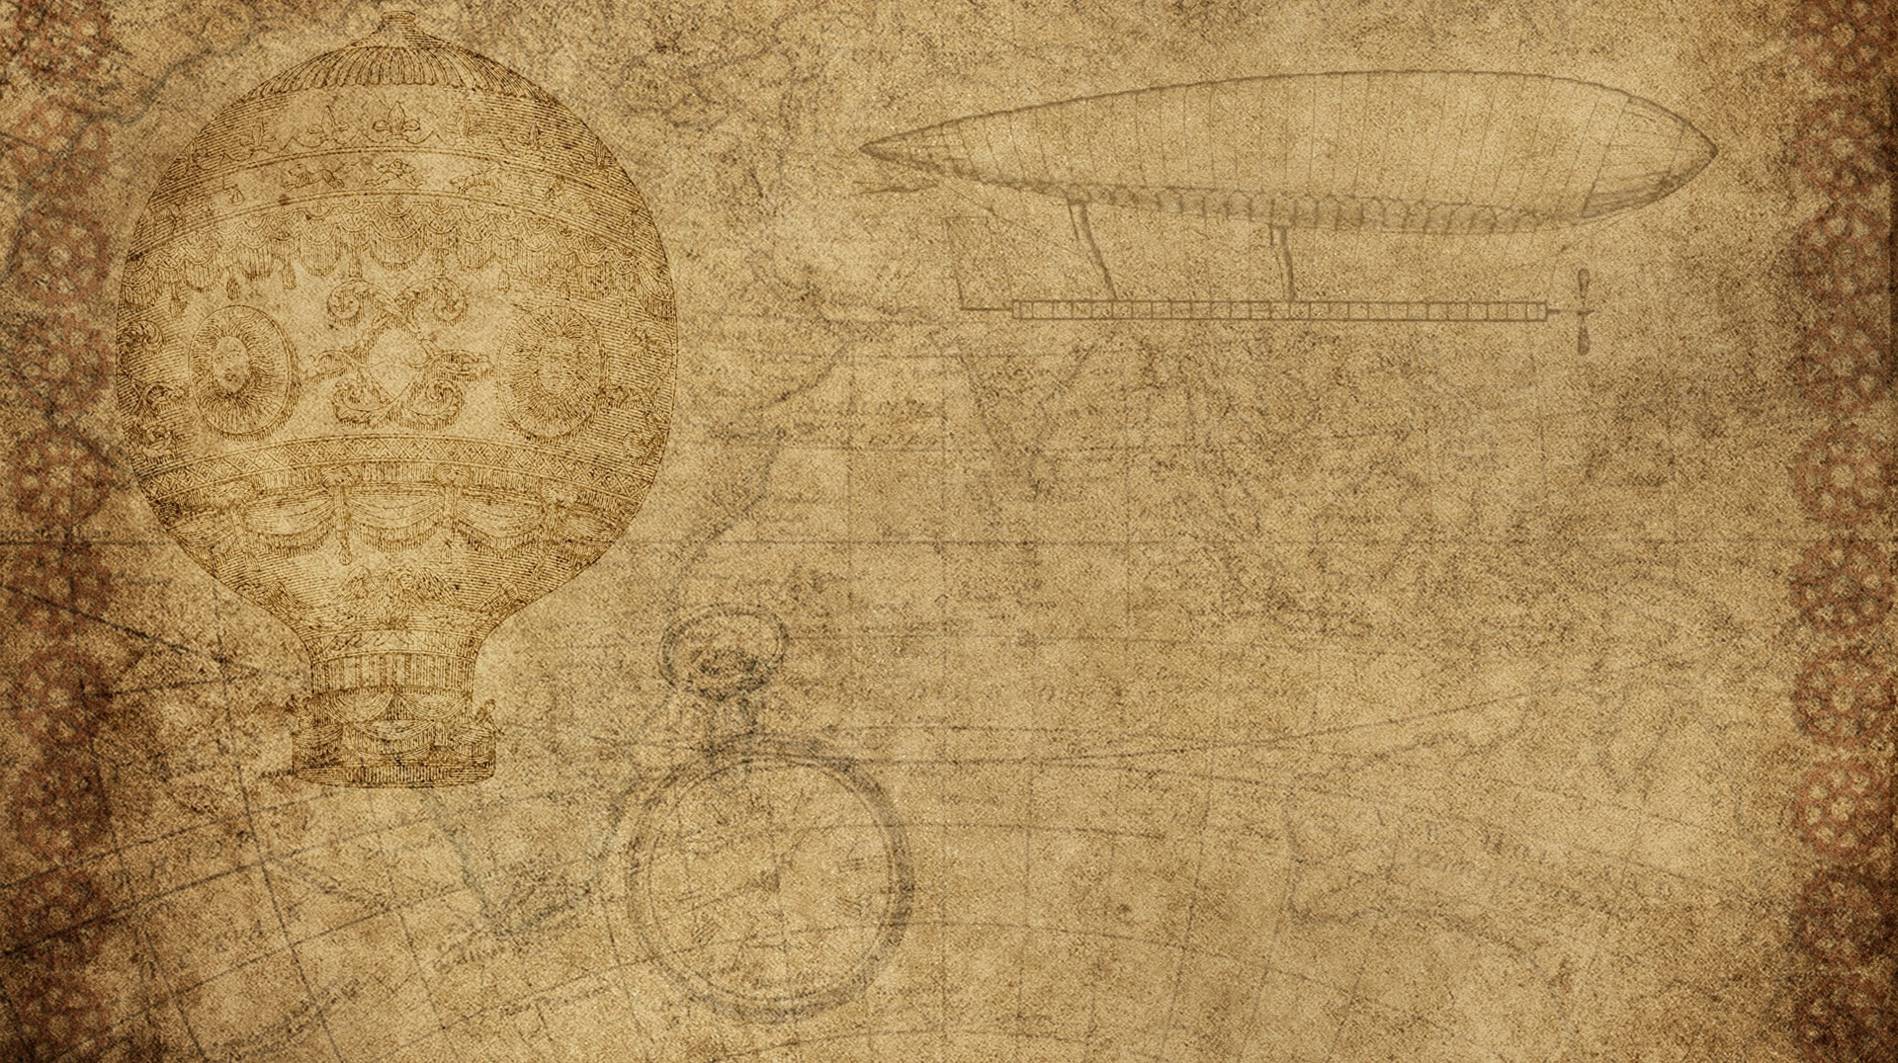

Smart fashion recommender application

Slide 2

Faculty mentor:
Raajan C
Team members:
S Diviyarasu
S Harikeerthan
L Kavibharath
S R Dhiwakar

Slide 3
Abstract
In recent years, the textile and fashion industries have witnessed an enormous amount of
growth in fast fashion. On e-commerce platforms, where numerous choices are available, an efficient
recommendation system is required to sort, order, and efficiently convey relevant product content or information to users. Image-based fashion recommendation systems (FRSs) have attracted a huge
amount of attention from fast fashion retailers as they provide a personalized shopping experience
to consumers. With the technological advancements, this branch of artificial intelligence exhibits
a tremendous amount of potential in image processing, parsing, classification, and segmentation.

Slide 4

methodologies
In this project, we propose a model that uses Convolutional Neural Network and the Nearest neighbour backed recommender. As shown in the figure Initially, the neural networks are trained and then an inventory is selected for generating recommendations and a database is created for the items in inventory. The nearest neighbour’s algorithm is used to find the most relevant products based on the input image and recommendations are generated.

Slide 5
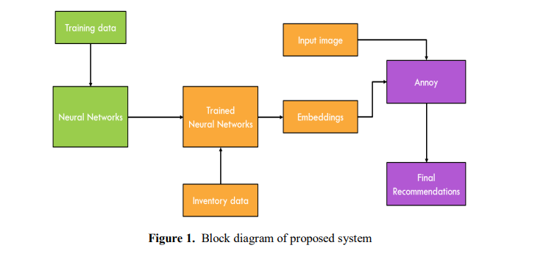
Method diagram

Slide 6
Skills need to be learned
IBM Cloud,
HTML,
Javascript,
IBM Cloud Object Storage,
Python-Flask,
Kubernetes,
Docker,
IBM DB2,
IBM Container Registry.

Slide 7
Features added
Using chatbot we can manage user's choices and orders.
The chatbot can give recommendations to the users based on their interests.
It can promote the best deals and offers on that day.
It will store the customer's details and orders in the database.
The chatbot will send a notification to customers if the order is confirmed.
Chatbots can also help in collecting customer feedback.

Slide 8
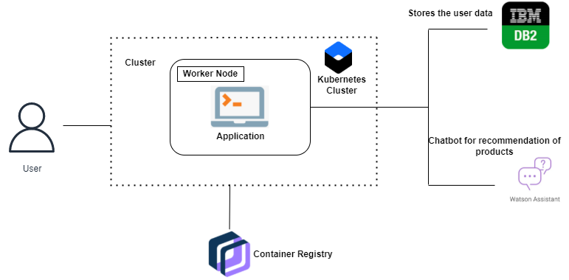
Technical Architecture:

Slide 9
Literature survey
Fashion Recommendation Systems, Models and Methods: A Review
Authors:-
Samit Chakraborty,
Md. Saiful Hoque,
Naimur Rahman Jeem,
Manik Chandra Biswas ,
Deepayan Bardhan,
Edgar Lobaton.
Reference:-
Barnard, M. Fashion as Communication, 2nd ed.; Routledge: London, UK, 2008.
Chakraborty, S.; Hoque, S.M.A.; Kabir, S.M.F. Predicting fashion trend using runway images: Application of logistic regression in trend forecasting. Int. J. Fash. Des. Technol. Educ. 2020, 13, 376–386. [CrossRef]
Karmaker Santu, S.K.; Sondhi, P.; Zhai, C. On application of learning to rank for e-commerce search. In Proceedings of the 40th International ACM SIGIR Conference on Research and Development in Information Retrieval, Shinjuku, Tokyo, Japan, 7–11 August 2017; pp. 475–484. [CrossRef]

Slide 10
Recommendation system development for fashion retail ecommerce
Authors:-
Kyung Jin Cha
References:-
Category Recommendations in E-commerce System, Max Leander.
Expanding Click and Buy rates: Exploration of evaluation metrics that measure the impact of personal,Drimik,Roy Chowdhury, Namrata Chaudhary.

Slide 11
REDEFINING THE OFFLINE RETAIL EXPERIENCE : DESIGNING PRODUCT RECOMMENDATION SYSTEMS FOR FASHION STORES
Authors:-
Hanke, Jannis, University of Würzburg, Germany, jannis.hanke@uni-wuerzburg.de
Hauser, Matthias, University of Würzburg, Germany, matthias.hauser@uni-wuerzburg.de
Dürr, Alexander, University of Würzburg, Germany, alexander.duerr@uni-wuerzburg.de
Thiesse, Frédéric, University of Würzburg, Germany, frederic.thiesse@uni-wuerzburg.de
Reference:-
Adomavicius, G. and A. Tuzhilin (2005). “Toward the next generation of recommender systems: A survey of the state-of-the-art and possible extensions.” IEEE transactions on knowledge and data engineering 17(6), 734–749.
Adomavicius, G. and A. Tuzhilin (2011). “Context-aware recommender systems.” In: Recommender systems handbook. Springer, pp. 217–253.

Slide 12
Personalized fashion recommender system with - image based neural networks
Authors:-
Mayur Rahul,
Parashuram Pal,
Vikash
References:-
Affective Recommender Systems Techniques, Khamael Raqim Raheem and Israa Hadi Ali
A Comprehensive Study of Recommender Systems for the Internet of Things, Mudita and Deepali Gupta.

